Slide 1
A Mixed-Methods Analysis of Virtual Sociology in World of Warcraft
University of Central Florida
IDS6916 – Research Methods
Fall 2019
Senior Design Project
Jordan Dauble, Simon Soschinski, Emmanuel Otero, Rhyse Bendell

Slide 2

Personality, Preferences, and Personal Impact in the Virtual

Slide 3
Overview
Background: Why should we care about video game play?
Context: Does World of Warcraft provide a meaningful test case?
Present Research: How can we quantify the impact of video game play?
End-game: What does this research contribute?

Slide 4
Background
Video games have superseded television as the main form of media consumed in first world countries
Increasingly, young people turn to video games for self-fulfillment within virtual worlds
A multiplicity of questions surround the relationship between individuals and their interaction with video games
Few empirical studies have rendered any meaningful data regarding the issue of the impact of video games on individuals’ behaviors
Notes:
Video games have superseded television as the main form of media consumed in first world countries [1]
Few empirical studies have rendered any meaningful data regarding the issue of the impact of video games on individuals’ behaviors [5, 6]

Slide 5
questions
What facets define the relationship between a player and a game?
Can we predict the behaviors of players in game?
Is it possible to extend that prediction to players’ tendencies post-play?
If it is possible to connect predisposition to virtual enaction, and virtual enaction to post-action, can predisposition alone predict post-action?

Slide 6
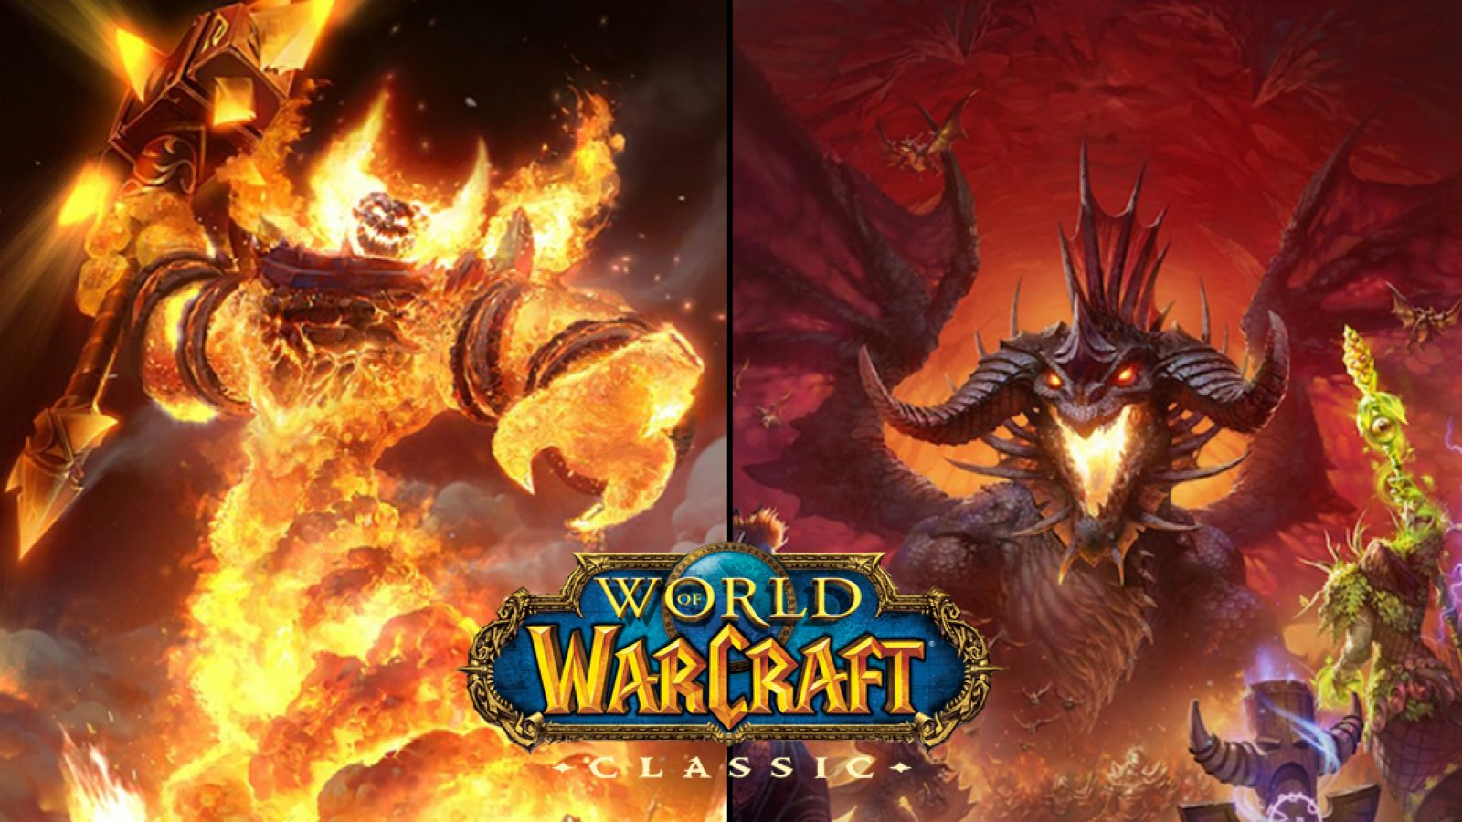

Slide 7
Why World of Warcraft
The World of Warcraft is one of the most played massive-multiplayer online role-playing games that has ever existed
The reach and implications of the player community of WoW can spans age, socioeconomic status, motivation to play, and many other measures by which we typically discretize humanity
The re-release of Classic WoW in August 2019 created renewed interest in playing World of Warcraft and brought back many players who had left the game over the years.

Slide 8
What is World of Warcraft
Massive-Multiplayer Online Role-Playing Game
The classic game takes place in the world of Azeroth
Players are engaged with in-game struggles such as the battle between the Alliance and the Horde, and for accomplishments and prestige
The overarching theme of the game is that players seek to accomplish successful character building while defeating the challenges presented in the game world

Slide 9


Factions of World of Warcraft

Slide 10
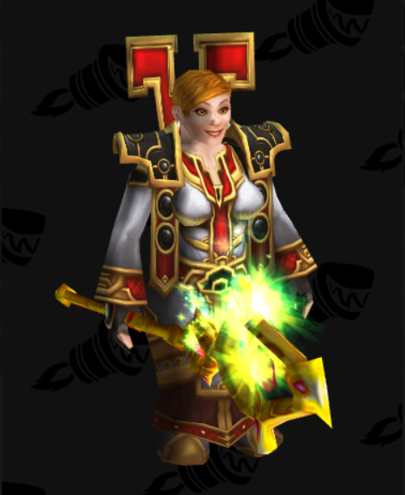
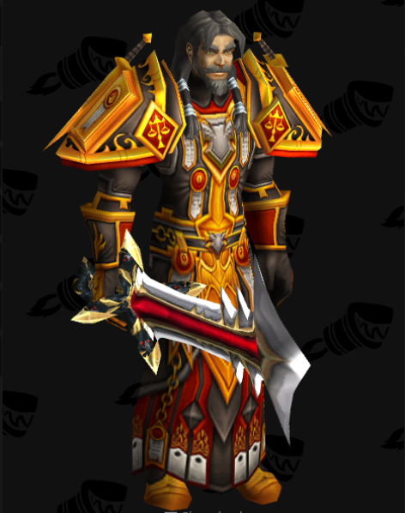

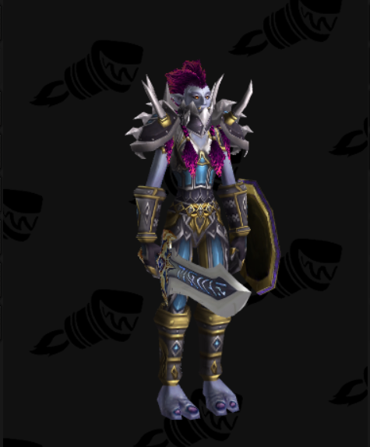
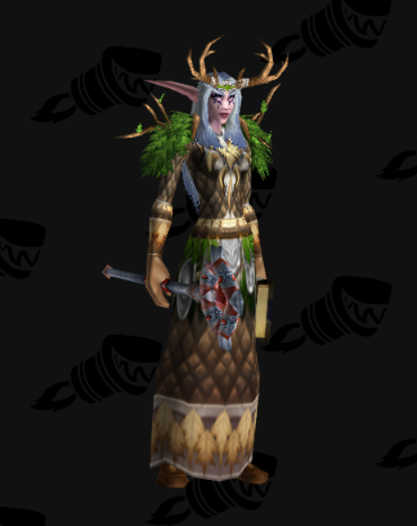
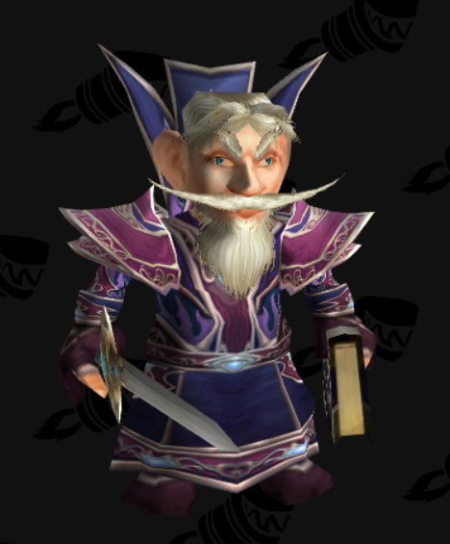
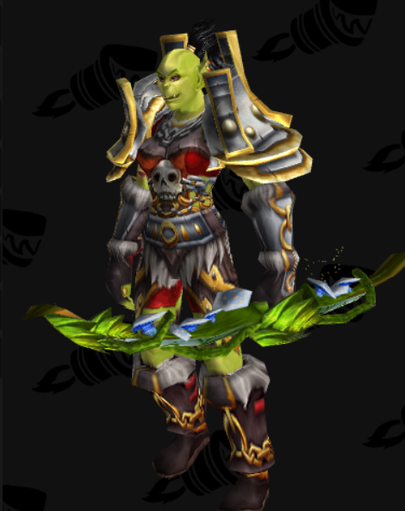
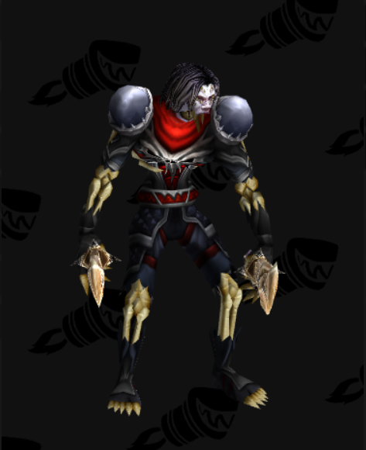
Races of World of Warcraft
Dwarfs
Humans
Tauren
Trolls
Night Elves
Gnomes
Orcs
Undead

Slide 11









Classes of World of Warcraft
Druid
Hunter
Mage
Paladin
Warrior
Priest
Rogue
Shaman
Warlock

Slide 12
Character Roles IN World of Warcraft
Tank
Frontline in a fight against non-player enemies; use their skillset and toolkit to draw the enemy’s attention and have them focus their attacks on themselves
DPS
Deal damage to bring an enemies hit points to zero before the healer runs out of mana
Healer
Refills party members’ health pools; enables the party to keep going with the fight and saves his allies should they be carelessly taking damage.

Slide 13
Play-Styles IN World of Warcraft
Player versus Environment
focuses on besting enemies not controlled by other players but by the game
Player versus Player
players tend to compete with other players in different competitions
Role playing
focusing more on embodying their character and socialize within the game world

Slide 14
Scientific Approach

Slide 15
Why Personality and WoW?
Bean and Groth-Marnat built upon previous findings to show that personality measures can predict play-style choices in WoW
Additionally, individual items of the Big-Five Index were associated with players’ biological sexes
The findings of their study may have been obscured by the number of choices available to players as well as non-directional hypotheses
Notes:
Bean and Groth-Marnat built upon previous findings to show that personality measures can predict play-style choices in WoW (7)

Slide 16
Why This Research?
This work aims to predict WoW players’ biological sex, chosen character sex, chosen alignment, chosen class, and preferred play-style with additional consideration of the effect that player recurrence may have on the BFI model’s predictive power.
We will build directly on the findings of Bean and Groth-Marnat (2016) and include additional measures which have the potential to reveal effects that may have been obscured in the previous research.

Slide 17
Methods

Slide 18
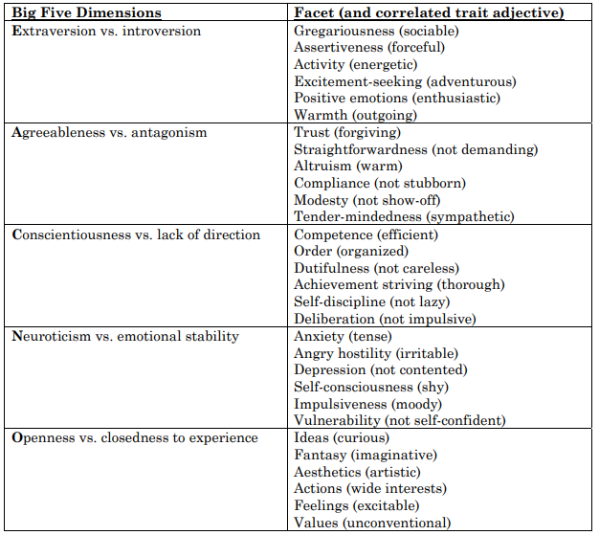
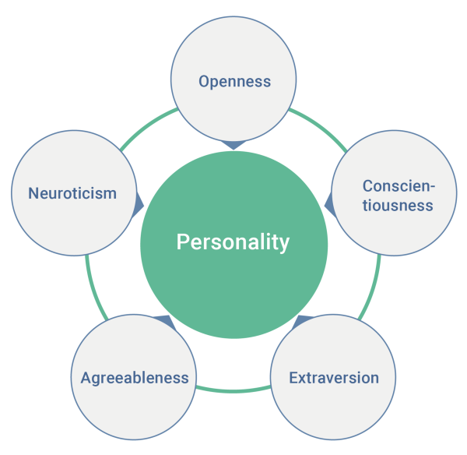
BFI

Slide 19
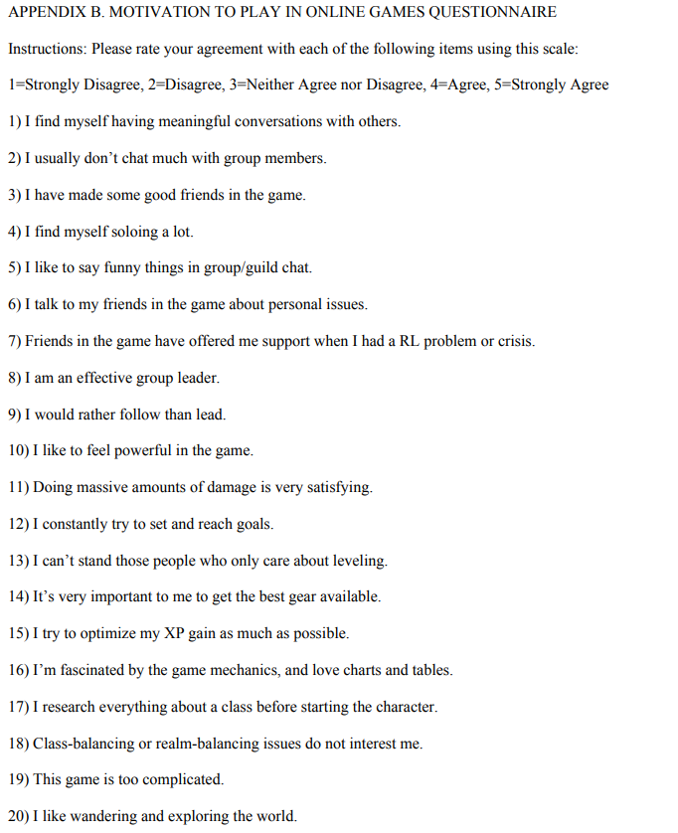
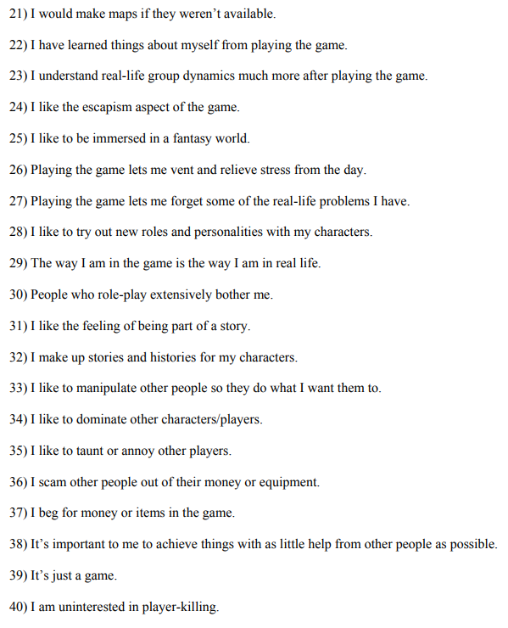
Motivation

Slide 20
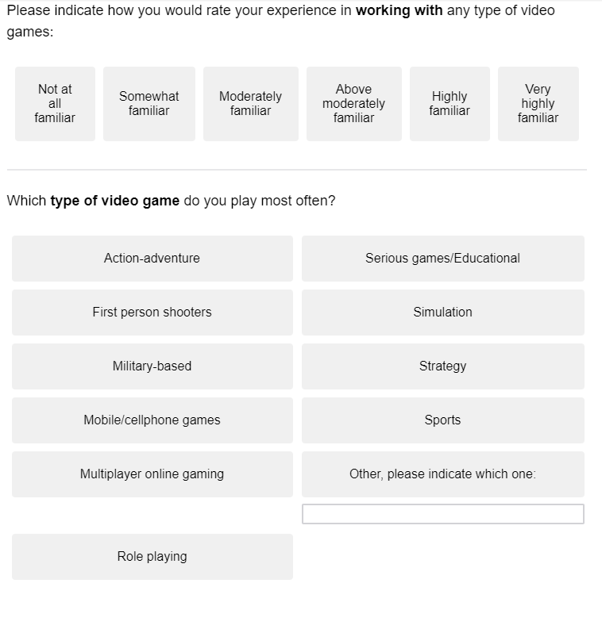
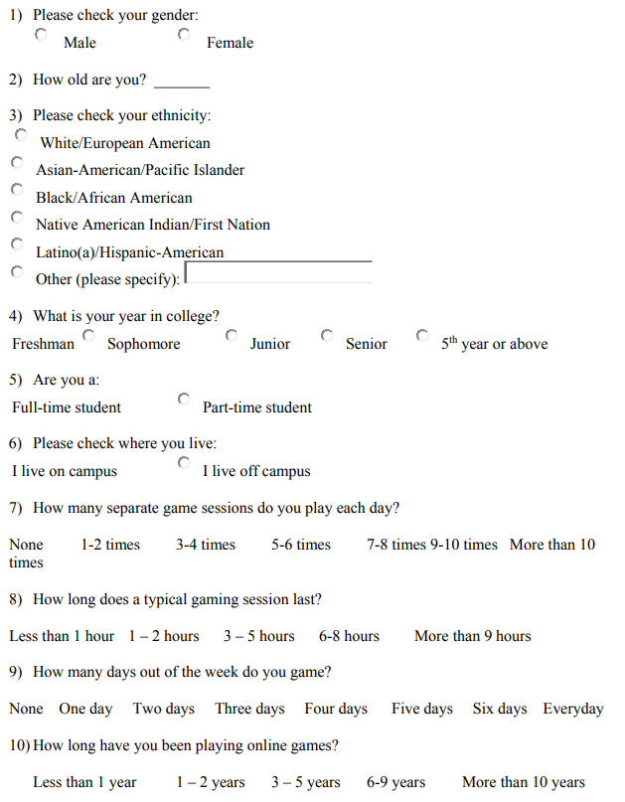
Demographics

Slide 21
World of Warcraft Probes
Will serve as the independent variable in this study: attempt to account for potentially varying interpretations of the probes used in Bean and Groth-Marnat (2016)
Your main (or most played) World of Warcraft character is: | Race | Class | Role | Play Style
If you were designing a World of Warcraft character that you would identify with they would be: | Race | Class | Role | Play Style

Slide 22
Hypotheses
H1: Responses to WoW probes regarding designing a character with which they identify will be predicted by BFI measures with larger effect sizes than responses based on players’ main characters.
H2: A combination of higher Extraversion scores, lower Agreeableness scores, lower Neuroticism scores, and lower Openness scores will predict players’ biological sex such that those scores will correspond with male respondents.

Slide 23
Hypotheses
H3: A combination of higher Extraversion and lower Neuroticism scores will positively predict player preferences towards PvP play-styles as opposed to RP or PvE.
H4a: Participants’ personality traits will predict their free-responses to queries regarding race and class.
H5: Participants’ personality traits will predict their responses to reduced-choice forced queries regarding race and class.

Slide 24
Hypotheses
H6: A combination of increased Conscientiousness scores, increased agreeableness scores, and decreased Extraversion scores will predict players’ alignment such that those exhibiting those traits will be more likely to align with Alliance forces than the Horde.
H7a: Participants’ responses to the motivation to play online games scale with predict their choices of play style.
H7b: Participants’ responses to the motivation to play online games scale with predict their choices of character role.

Slide 25
References
(1) Billieux, J., Van der Linden, M., Achab, S., Khazaal, Y., Paraskevopoulos, L., Zullino, D., & Thorens, G. (2013). Why do you play World of Warcraft? An in-depth exploration of self-reported motivations to play online and in-game behaviours in the virtual world of Azeroth. Computers in Human Behavior, 29(1), 103-109.
(2) Bean, A. M. (2015). Video gamers' personas: A five factor study exploring personality elements of the video gamer. Pacifica Graduate Institute.
(3) Bean, A. M., Ferro, L. S., Vissoci, J. R. N., Rivero, T., & Groth-Marnat, G. (2016). The emerging adolescent World of Warcraft video gamer: A five factor exploratory profile model. Entertainment Computing, 17, 45-54.
(4) Crawford, J., Brandt, M. (2019). Who is prejudiced, and toward whom? The big five traits and generalized prejudice. Personality and Social Psychology Bulletin, 45(10), 1455-1467.
(5) John, O. P., & Srivastava, S. (1999). The Big-Five trait taxonomy: History, measurement, and theoretical perspectives. In L. A. Pervin & O. P. John (Eds.), Handbook of personality: Theory and research (Vol. 2, pp. 102–138). New York: Guilford Press.
(6) Kaspi-Baruch, O. (2017). Big Five Personality and Creativity: The Moderating Effect of Motivational Goal Orientation. The Journal of Creative Behavior, 53(3), https://doi-org.ezproxy.net.ucf.edu/10.1002/jocb.183
(7) Bean, A., & Groth-Marnat, G. (2016). Video gamers and personality: A five-factor model to understand game playing style. Psychology of Popular Media Culture, 5(1), 27.

Slide 26
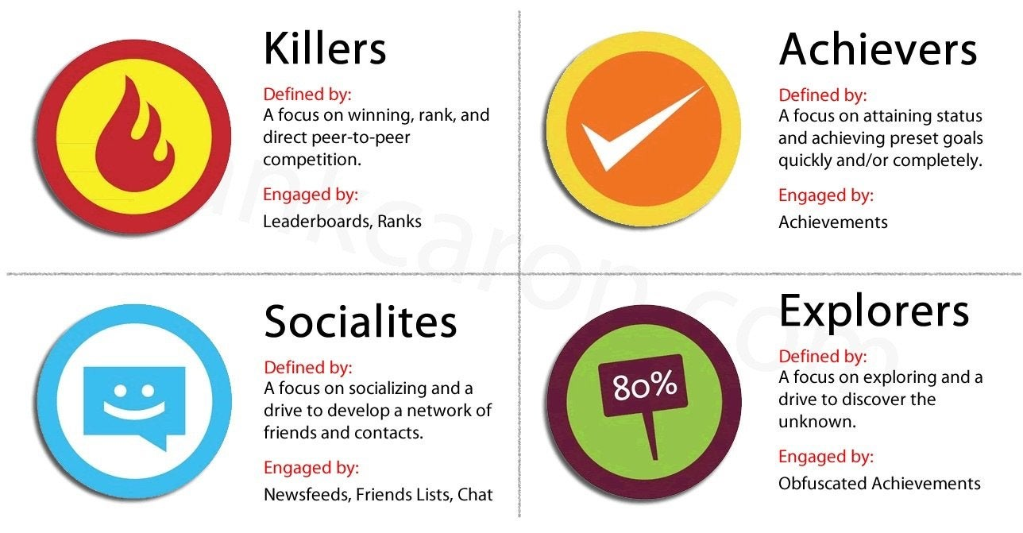
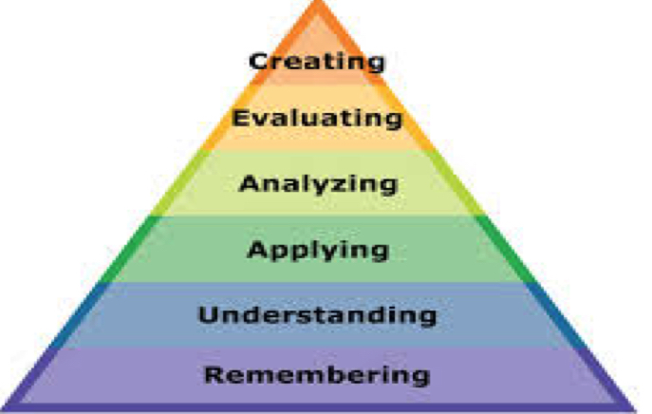
Studying Video-Gamers
Previous research into the self-reported and behavioral tendencies of video-gamers has yielded fascinating insight into individuals’ reasons to play as well as their motivations to engage with others.
A number of taxonomies have arisen which perceive themselves to be paramount to the discussion of video games.

